Slide 1

CPU Scheduling
PASS
It was interesting to see all of your detailed results. Thank you for sharing those. :-)
CS532: OS Foundations
Lab Assignment
Email: chitram2@pdx.edu

Slide 2
Instructions: Make a copy of this document, move your copy to your submissions folder and fill the document with your responses. Use the space on each slide to show your responses, and add additional slides as needed.
When ready for grading: complete the lab assignment submission form and include a link to your filled document

Slide 3
scheduler.py
Go to the cpu-sched sub-directory within your ostep-homework directory on babbage.cs.pdx.edu, and read the Readme.md file. Read this file thoroughly and try every example shown there. The scheduler.py program in this sub-directory allows you to measure and compare various scheduling algorithms using metrics such as response time, turnaround time and total wait time.
Use scheduler.py to help answer each of the questions in this assignment.

Slide 4
1. Compute the response time and turnaround time when running three jobs of length 400 with the SJF and FIFO schedulers.
 | Response time | Turnaround Time
SJF
FIFO

Slide 5
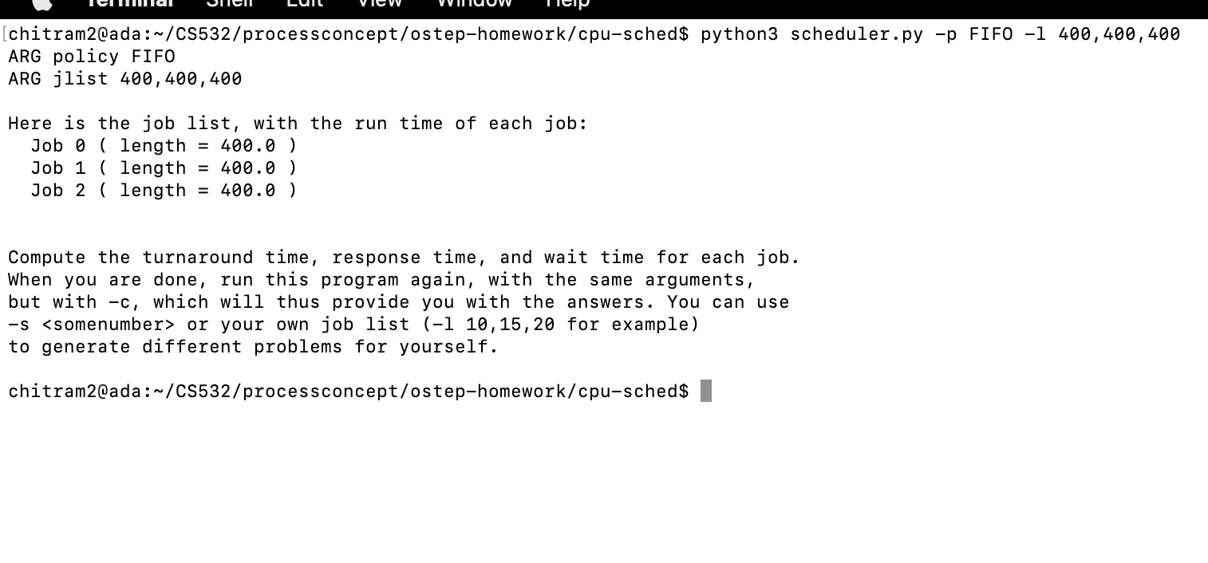

Slide 6
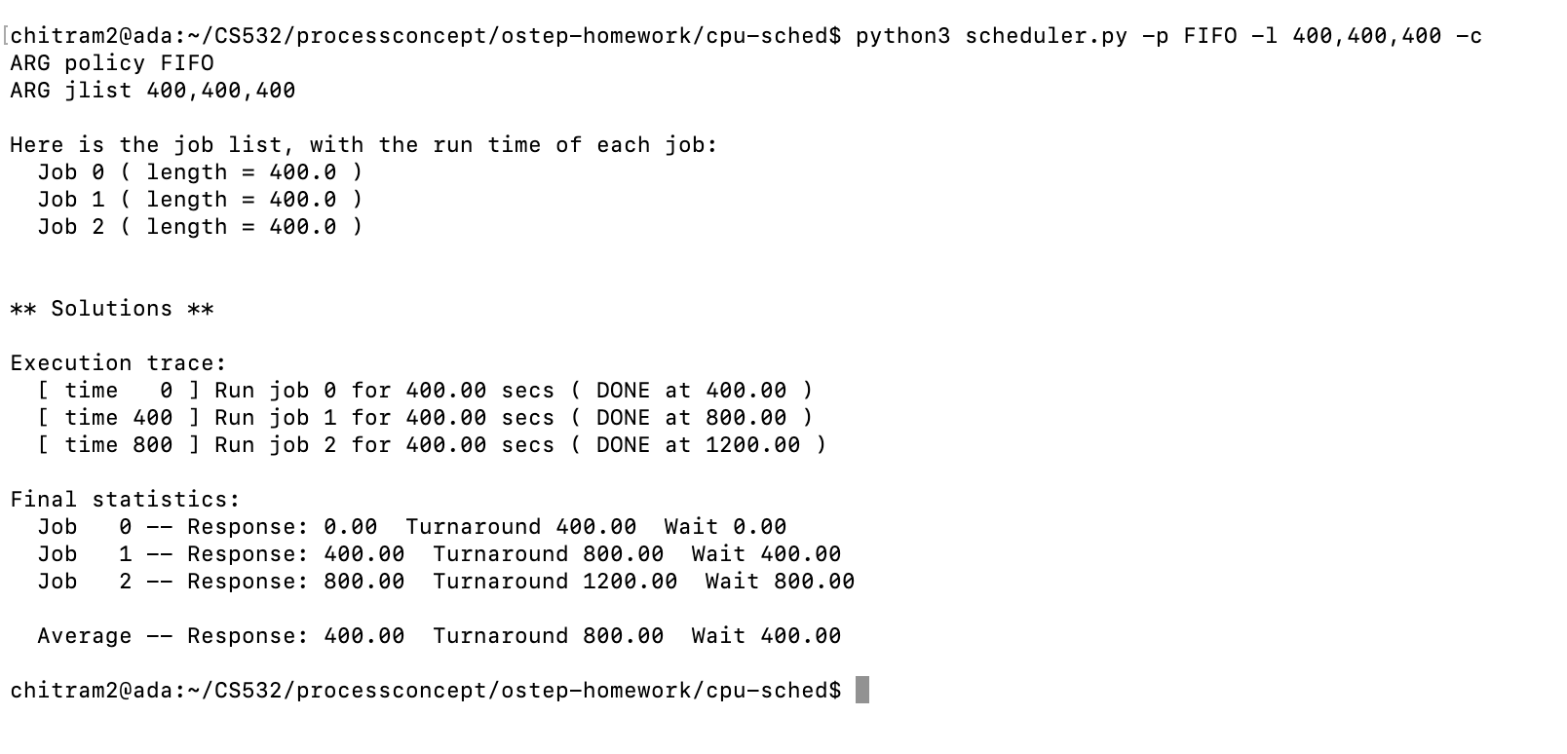

Slide 7
For the FIFO scheduling algorithm,
Start jobs in the order they arrive(FIFO queue). Run each job until completion.This is a non-preemptive scheduling algorithm.
To calculate the Response Time and Turnaround time:
Process 1 have wait as well as response time of 0. The total turnaround time will be at 400.
After Process 1 execution ends, Process 2 starts the execution process will have wait of 400 and the total turnaround time of 800.Response time will be 400 as well.
After process 2 execution ends, Process 3 starts the execution process will have wait of 800 and the total turnaround time of 1200.Response time will be 800 as well.

Slide 8
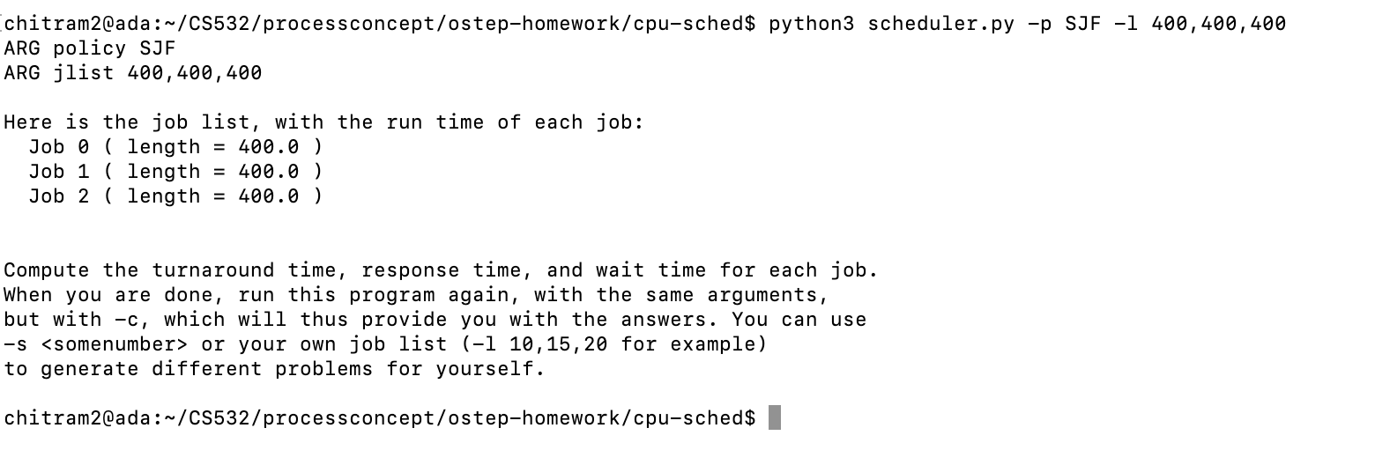

Slide 9
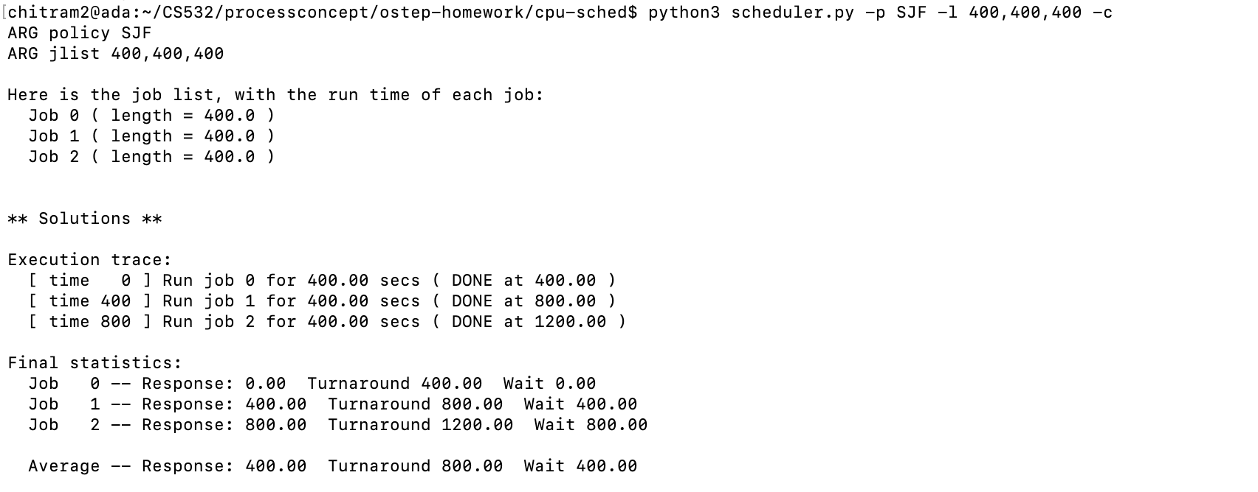

Slide 10
For the SJF schedulingalgorithm,
Select the job with the shortest running time.This can be a preemptive or non-preemptive scheduling algorithm. Preemptive SJF is also known as Shortest Time Remaining scheduling algorithm.
To calculate the Response Time and Turnaround time:
Process 1 have wait as well as response time of 0. The total turnaround time will be at 400.
After Process 1 execution ends, Process 2 starts the execution process will have wait of 400 and the total turnaround time of 800. Response time will be 400 as well.
After process 2 execution ends, Process 3 starts the execution process will have wait of 800 and the total turnaround time of 1200.Response time will be 800 as well.

Slide 11
FIFO Scheduling algorithm,
Process id | Delay(Wait time) | Response Time | Turnaround time
Process 1 | 0 | 0 | 400
Process 2 | 400 | 400 | 800
Process 3 | 800 | 800 | 1200
SJF Scheduling algorithm,
Process id | Delay(Wait time) | Response Time | Turnaround time
Process 1 | 0 | 0 | 400
Process 2 | 400 | 400 | 800
Process 3 | 800 | 800 | 1200

Slide 12
Final result
Good
Algorithm | Average wait time | Average Response time | Average Turnaround time
SJF | 400 | 400 | 800
FIFO | 400 | 400 | 800

Slide 13
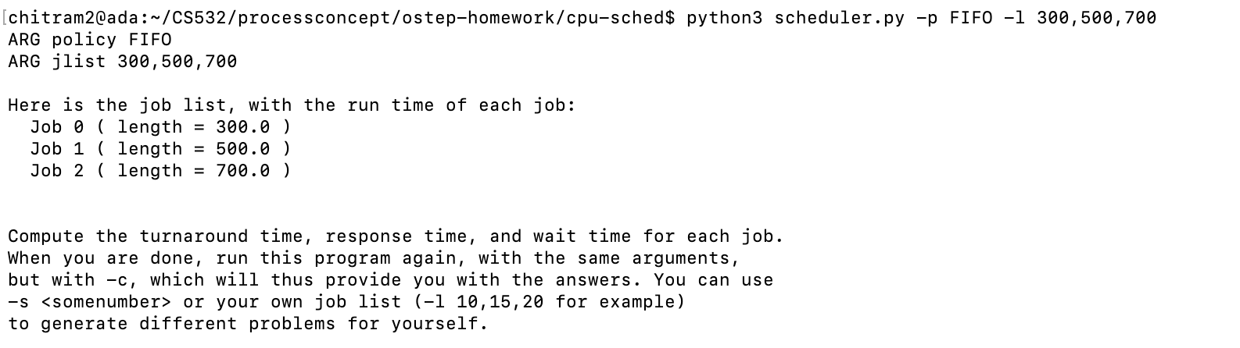
2. Now do the same but with jobs of different lengths: 300, 500, and 700.

Slide 14
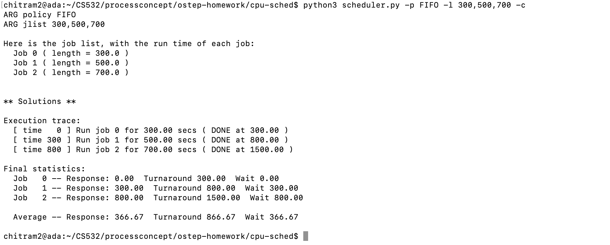

Slide 15
For the FIFO scheduling algorithm,
To calculate the Response Time and Turnaround time:
Process 1 have wait as well as response time of 0. The total turnaround time will be at 300.
After Process 1 execution ends, Process 2 starts the execution process will have wait of 300 and the total turnaround time of 800. Response time will be 300 as well.
After process 2 execution ends, Process 3 starts the execution process will have wait of 800 and the total turnaround time of 1500. Response time will be 800 as well.

Slide 16
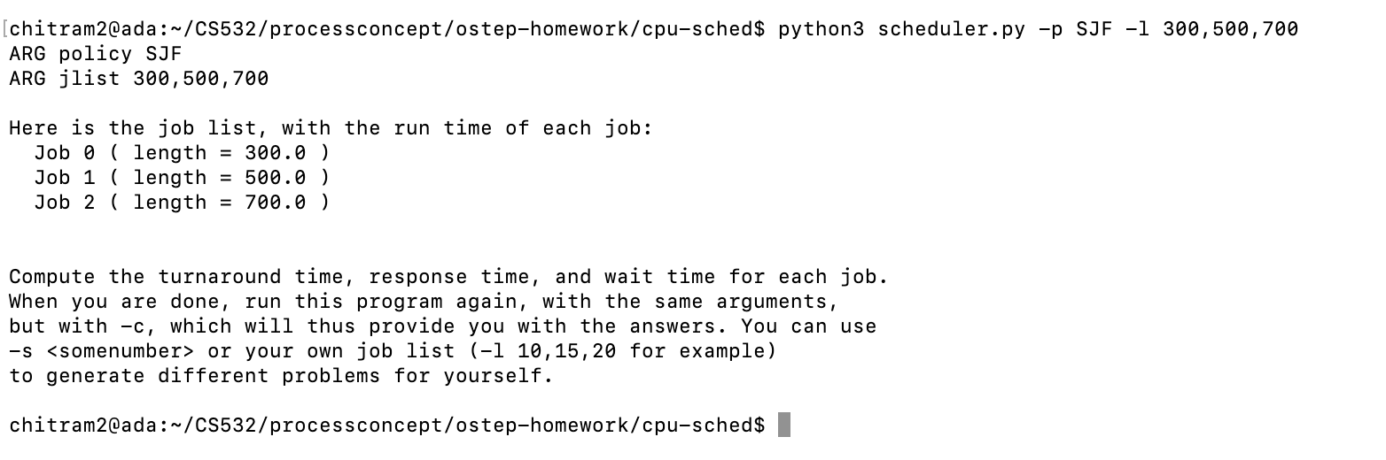

Slide 17
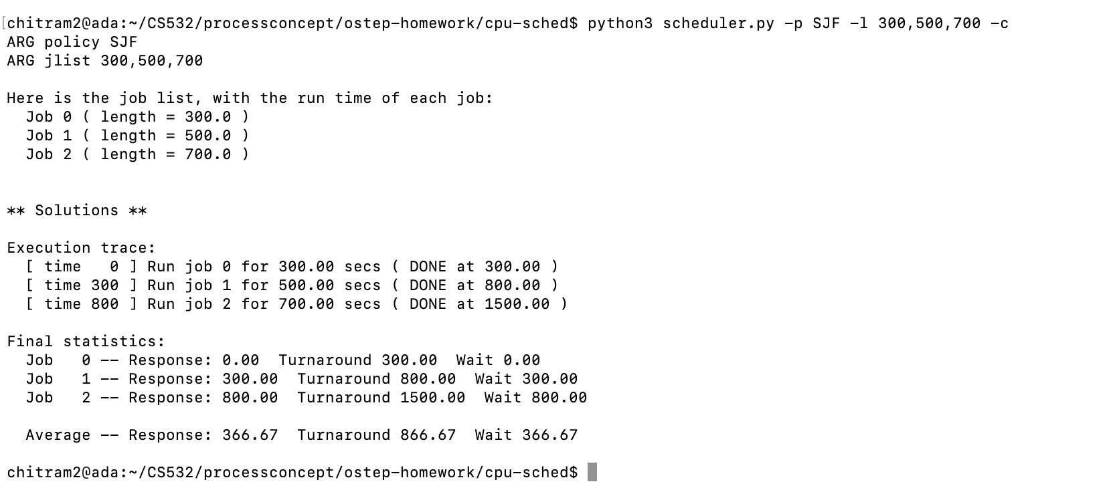

Slide 18
For the SJF scheduling algorithm,
To calculate the Response Time and Turnaround time:
Process 1 have wait as well as response time of 0. The total turnaround time will be at 300.
After Process 1 execution ends, Process 2 starts the execution process will have wait of 300 and the total turnaround time of 800. Response time will be 300 as well.
After process 2 execution ends, Process 3 starts the execution process will have wait of 800 and the total turnaround time of 1500. Response time will be 800 as well.

Slide 19
FIFO Scheduling algorithm,
Process id | Delay(Wait time) | Response Time | Turnaround time
Process 1 | 0 | 0 | 300
Process 2 | 300 | 300 | 800
Process 3 | 800 | 800 | 1500
SJF Scheduling algorithm,
Process id | Delay(Wait time) | Response Time | Turnaround time
Process 1 | 0 | 0 | 300
Process 2 | 300 | 300 | 800
Process 3 | 800 | 800 | 1500

Slide 20
Final result
Good
Algorithm | Average wait time | Average Response time | Average Turnaround time
SJF | 366.67 | 366.67 | 866.67
FIFO | 366.67 | 366.67 | 866.67

Slide 21

3. Now do the same, but also with the RR scheduler and a time-slice of 2.

Slide 22
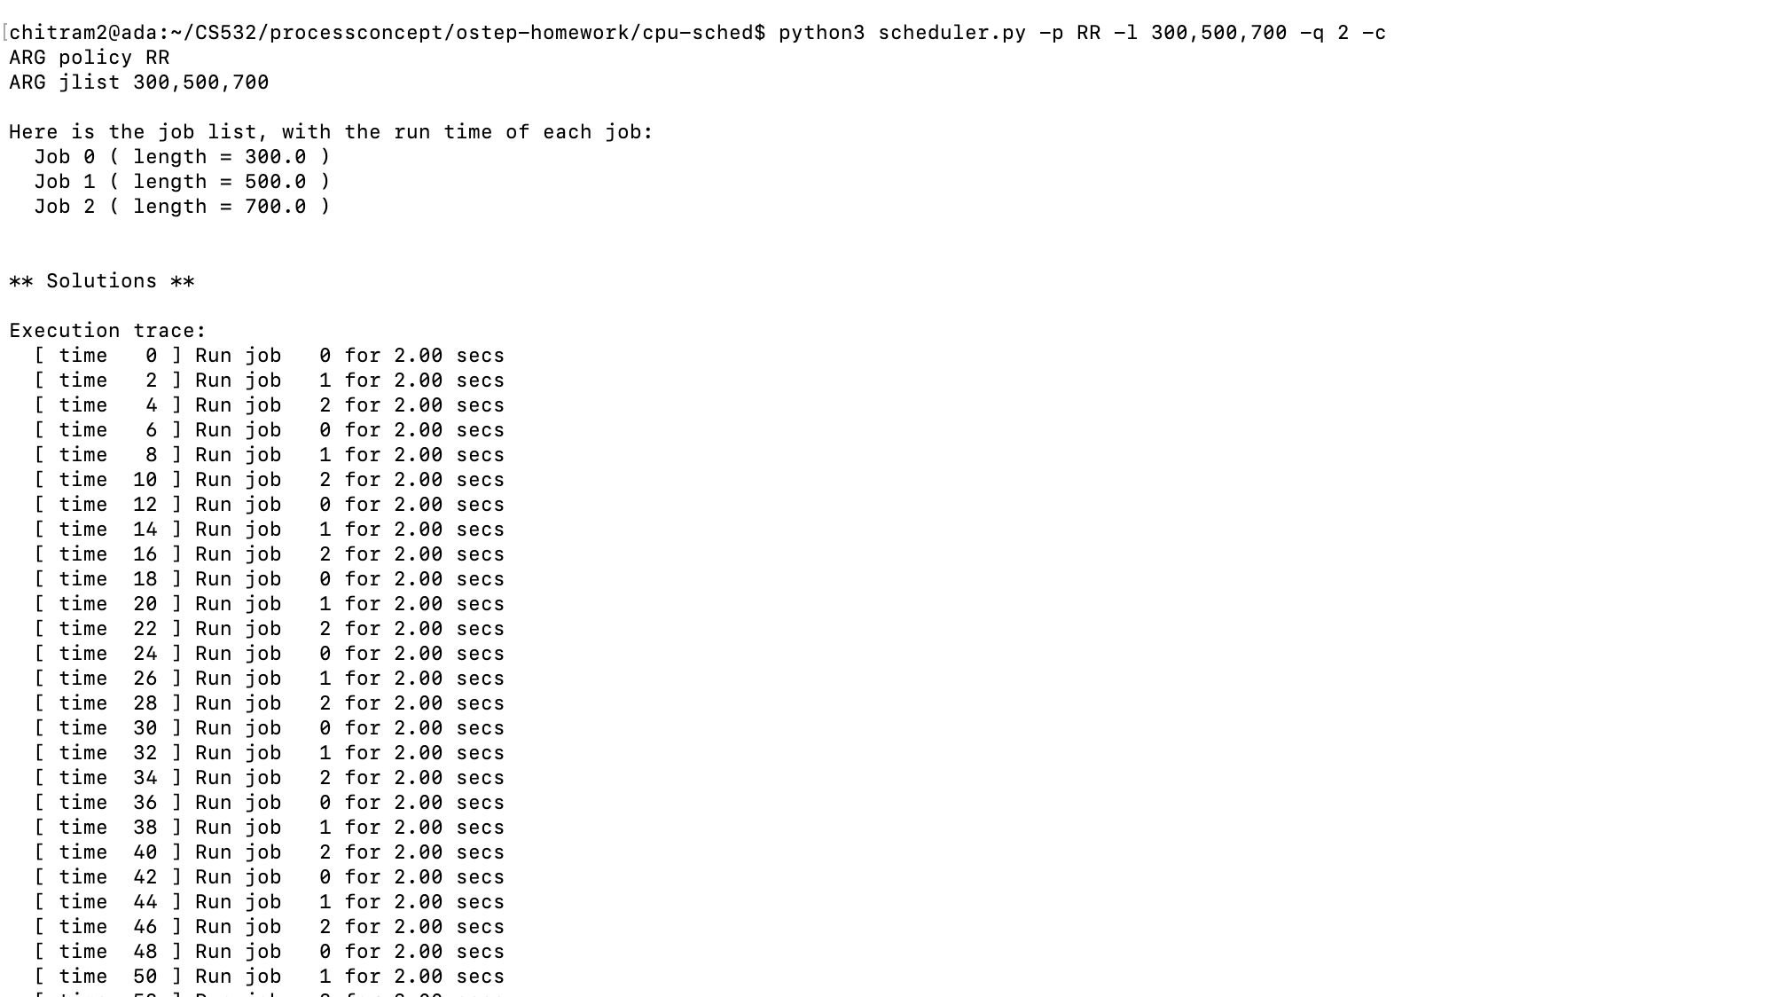

Slide 23
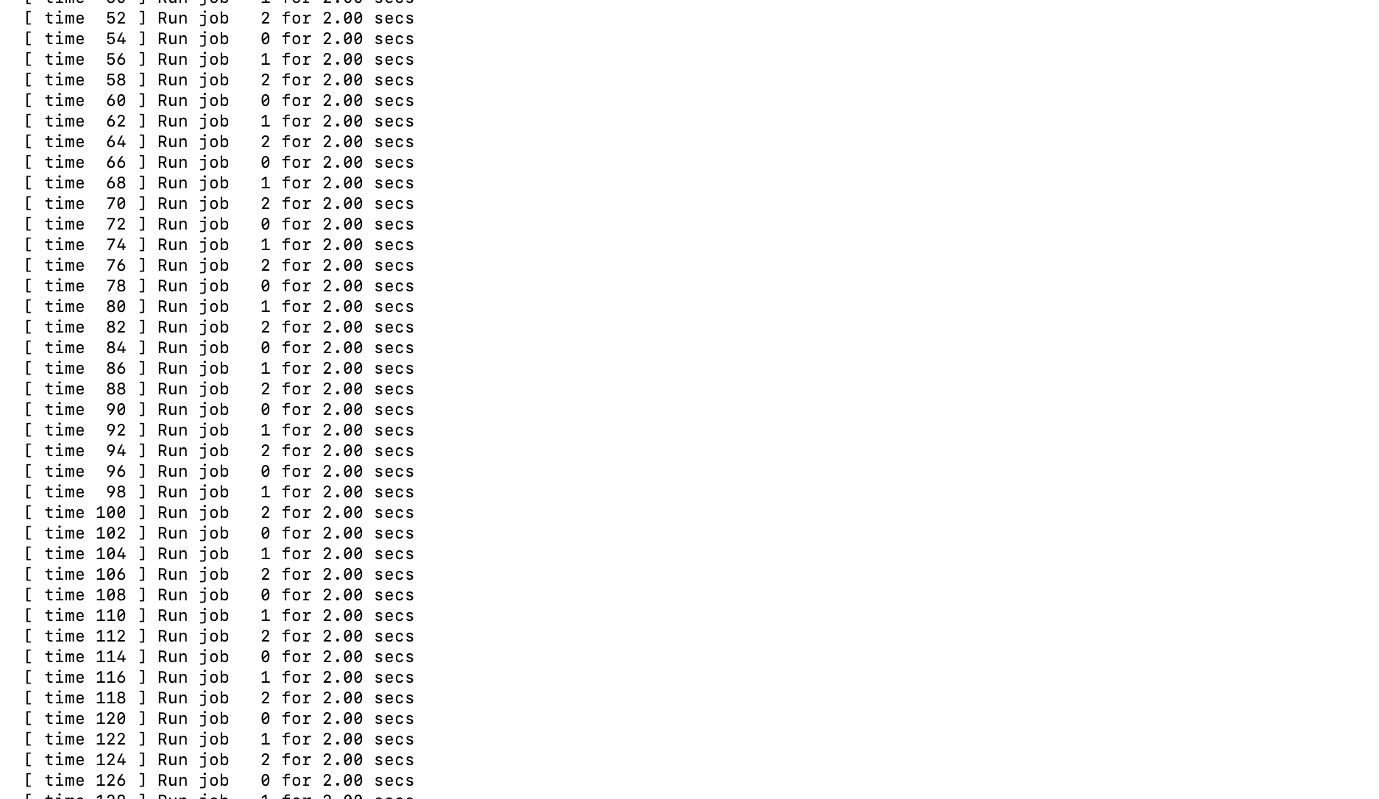

Slide 24
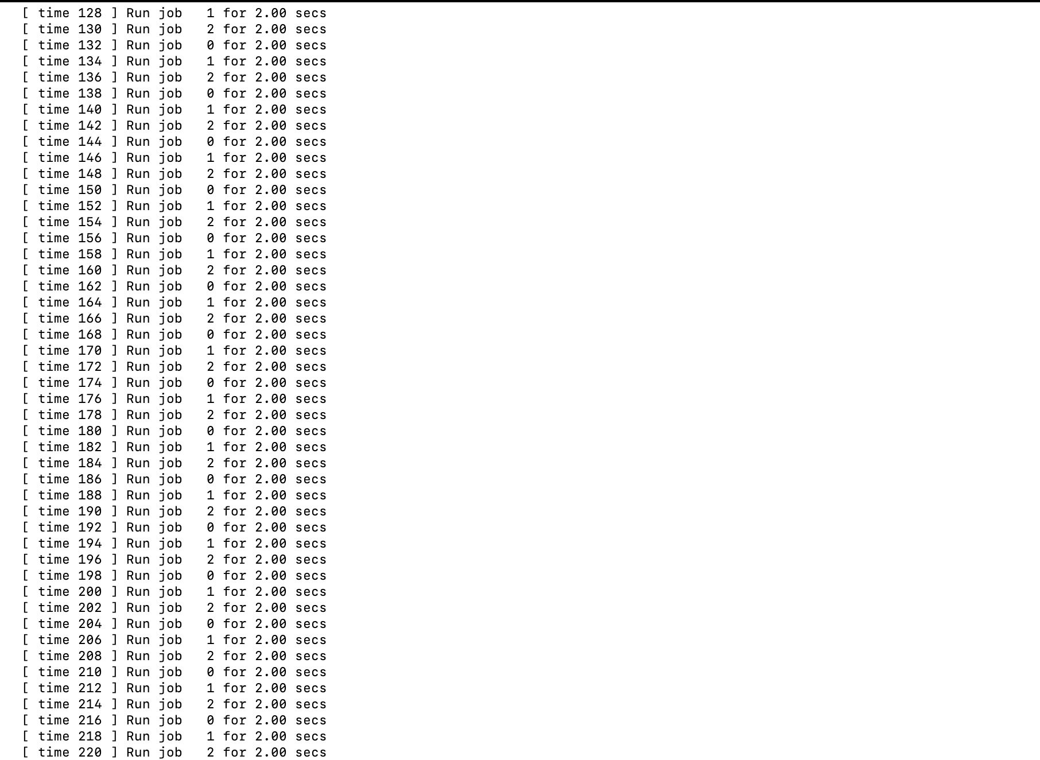

Slide 25
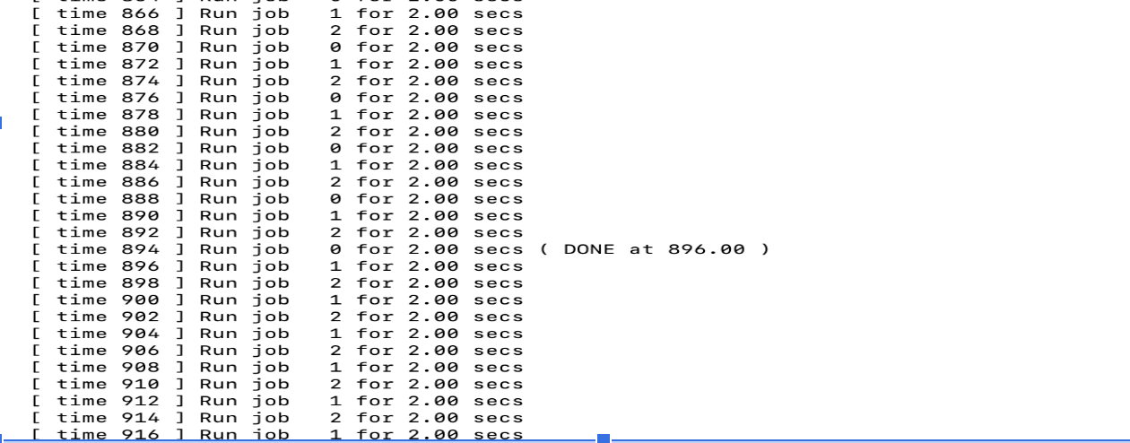
Process 0 finished at 896.00

Slide 26
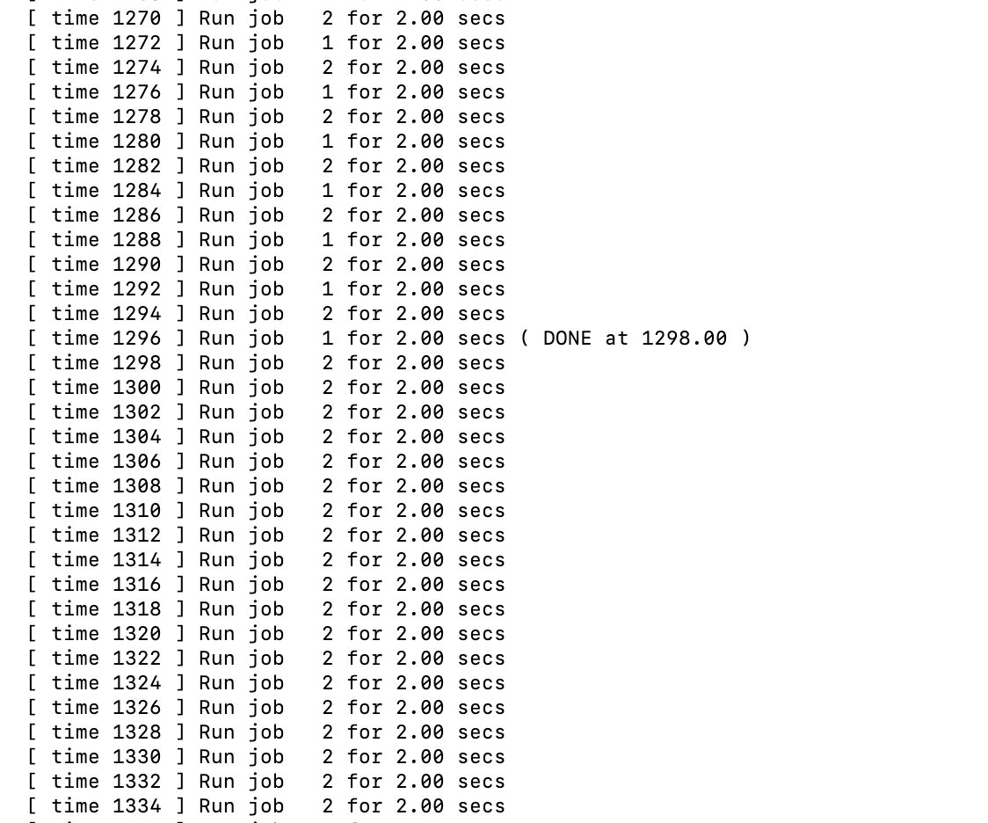
Process 1 finished at 1298.00

Slide 27
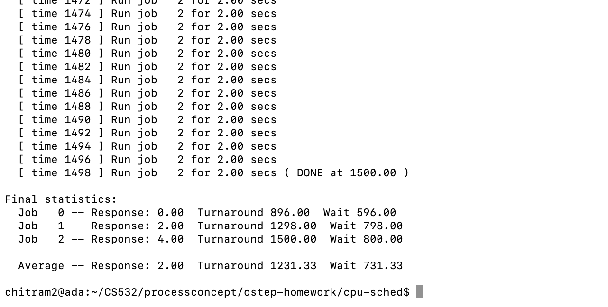
Process 2 finished at 1500.00

Slide 28
RR Scheduling algorithm,
To Calculate the Response Time and Turnaround time:
The Processes enter the process queue, the RR will check the execution time for all the processes and will run the process with the proper time frame(2 in our question).
Process 1 will be executed for the given time slice of 2 after which it will be pushed to the back of the process queue.
After the execution of process 1, Process 2 starts the executing for the time slice of 2.
After Process 2, Process 3 starts the executing for the time slice of 2.
This cycle will continue Once they enter the DONE state and other processes of the queue will keep on continuing in the same fashion.

Slide 29
Process id | Wait time | Response Time | Turnaround time
Process 1 | 596 | 0 | 896
Process 2 | 798 | 2 | 1298
Process 3 | 800 | 4 | 1500
Average wait time | Average Response time | Average Turnaround time
731.33 | 2 | 1231.33
Good

Slide 30
4. For what types of workloads does SJF deliver the same turnaround times as FIFO?
SJF deliver the same turnaround time as FIFO
- when all of the processes are of the same size.(400- each enter the process queue)
- when the jobs always increase in size(eg: Shortest job arrives first)
Good

Slide 31
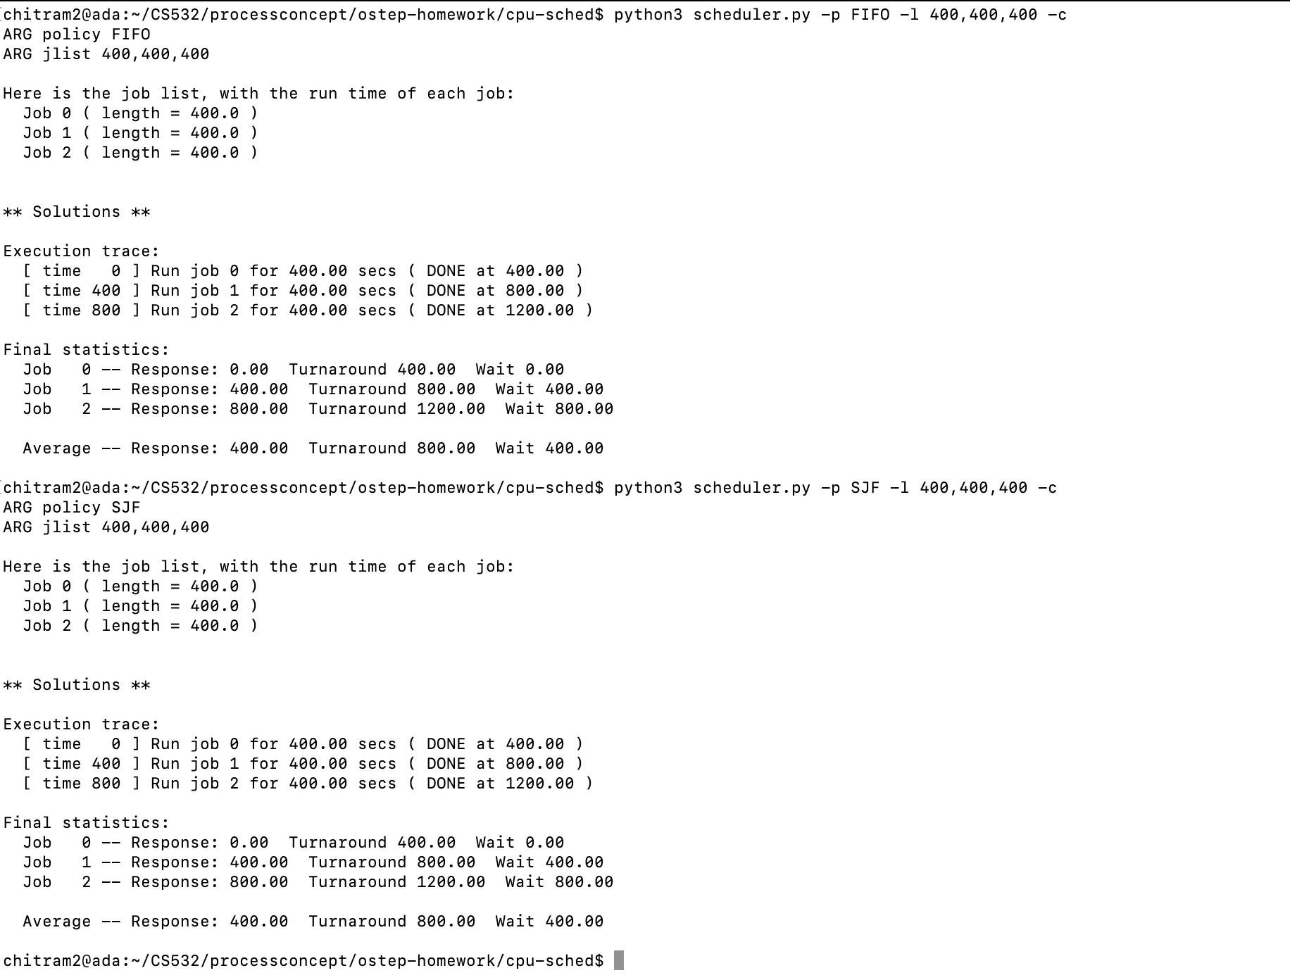

Slide 32
For FIFO scheduling algorithm : python3 scheduler.py -p FIFO -l 400,400,400 -c
Process id | Wait time | Response Time | Turnaround time
Process 1 | 0 | 0 | 400
Process 2 | 400 | 400 | 800
Process 3 | 800 | 800 | 1200
For SJF Scheduling algorithm:python3 scheduler.py -p SJF -l 400,400,400 -c
Process id | Wait time | Response Time | Turnaround time
Process 1 | 0 | 0 | 400
Process 2 | 400 | 400 | 800
Process 3 | 800 | 800 | 1200

Slide 33
Final result
Algorithm | Average wait time | Average Response Time | Average Turnaround Time
SJF | 400 | 400 | 800
FIFO | 400 | 400 | 800

Slide 34
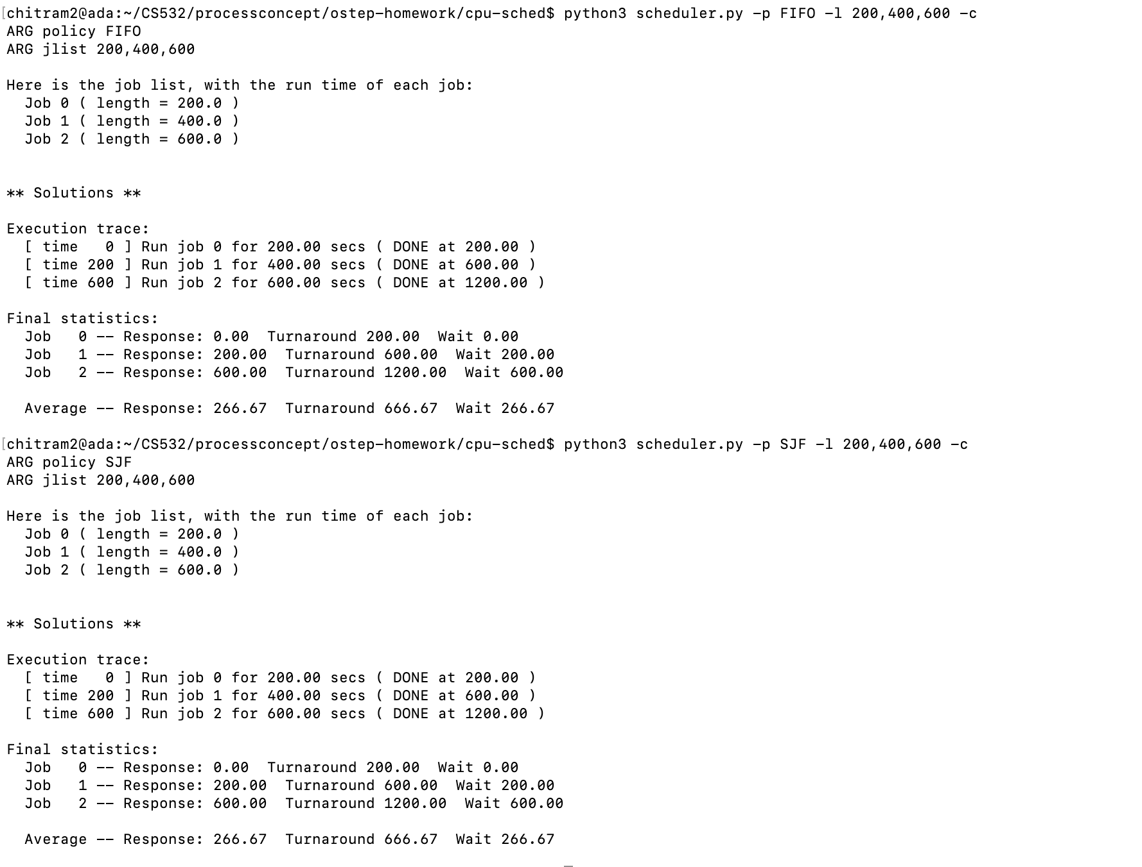

Slide 35
For FIFO scheduling algorithm : python3 scheduler.py -p FIFO -l 200,400,600 -c
Process id | Wait time | Response Time | Turnaround time
Process 1 | 0 | 0 | 200
Process 2 | 200 | 200 | 600
Process 3 | 600 | 600 | 1200
For SJF Scheduling algorithm:python3 scheduler.py -p SJF -l 200,400,600 -c
Process id | Wait time | Response Time | Turnaround time
Process 1 | 0 | 0 | 200
Process 2 | 200 | 200 | 600
Process 3 | 600 | 600 | 1200

Slide 36
Final result
Algorithm | Average wait time | Average Response Time | Average Turnaround Time
SJF | 266.67 | 266.67 | 666.67
FIFO | 266.67 | 266.67 | 666.67

Slide 37
5. For what types of workloads and quantum lengths does SJF deliver the same response times as RR?
SJF deliver the same response time as RR when the scheduling time quantum of RR is greater than the largest job. There is no preemption in round robin scheduling which will yield results as that of SJF. This is possible only when the jobs arrive in the process queue in the order of increasing job size.
Good
Or equal to

Slide 38
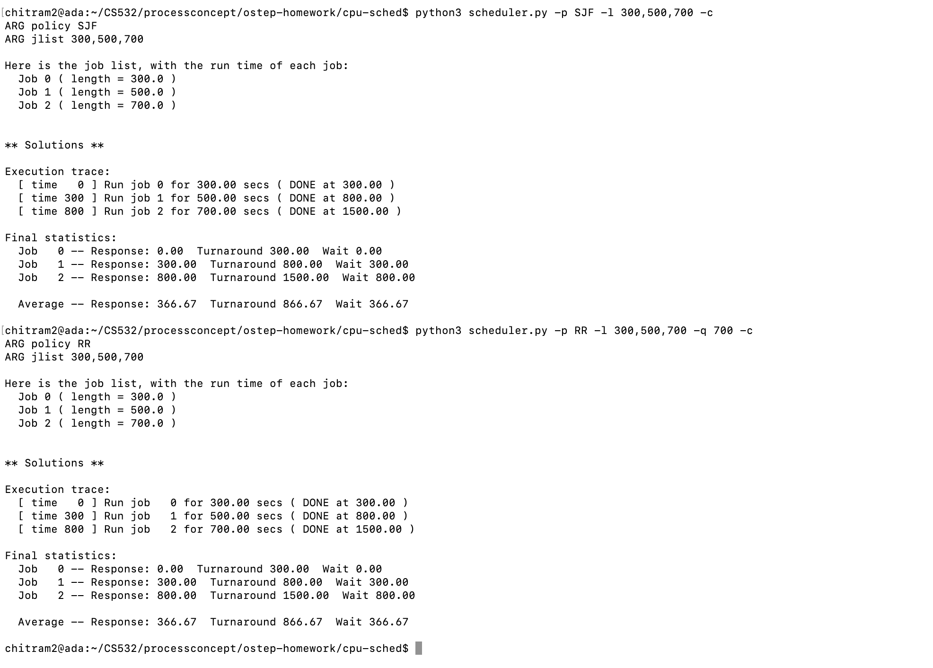

Slide 39
For SJF scheduling algorithm : python3 scheduler.py -p SJF -l 300,500,700 -c
Process id | Wait time | Response Time | Turnaround time
Process 1 | 0 | 0 | 300
Process 2 | 300 | 300 | 800
Process 3 | 800 | 800 | 1500
For RR Scheduling algorithm:python3 scheduler.py -p RR -l 300,500,700 -q 700 -c
Process id | Wait time | Response Time | Turnaround time
Process 1 | 0 | 0 | 300
Process 2 | 300 | 300 | 800
Process 3 | 800 | 800 | 1500

Slide 40
6. What happens to response time with SJF as job lengths increase? Can you use scheduler.py to demonstrate the trend?
When using SJF, when the job lengths increase, then the average response time also increases.
Good

Slide 41
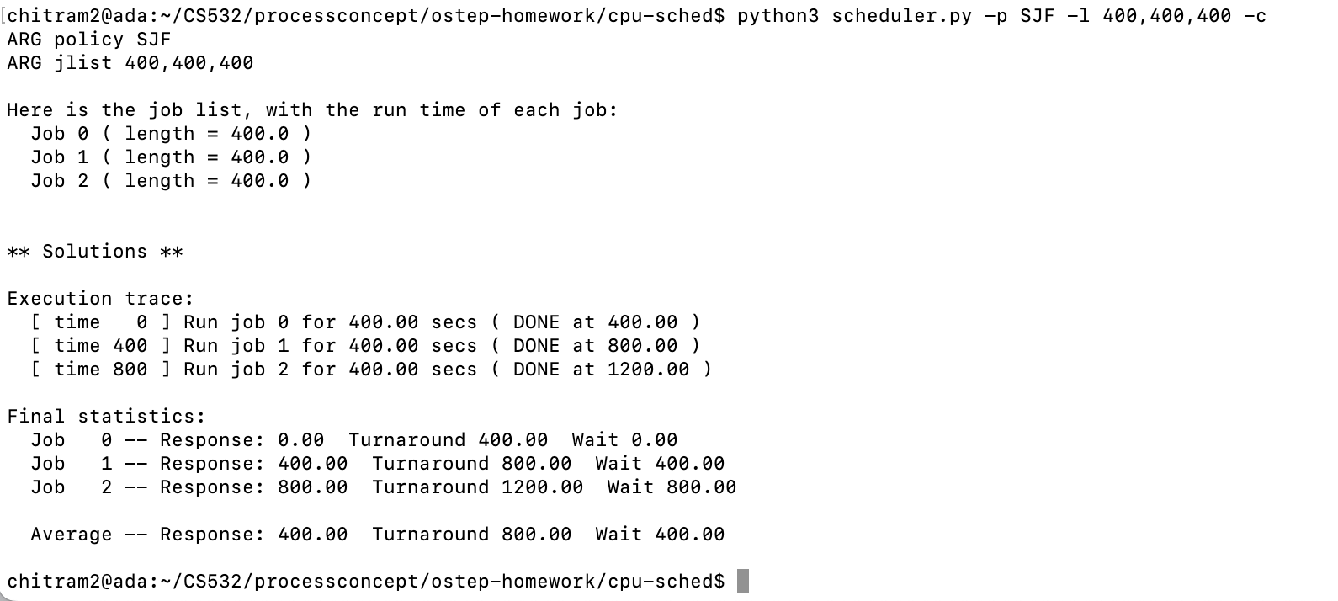
EX1:when the job lengths are equal

Slide 42
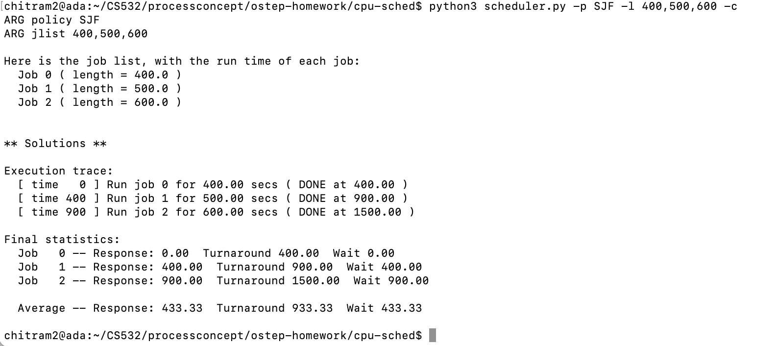
EX 2: When job lengths are increased by 100 instructions per job.

Slide 43
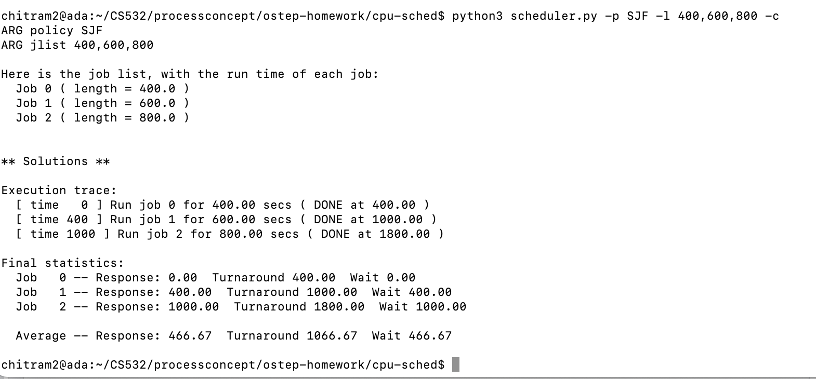
EX 3: When the job lengths are increased by 200 per next instructions.

Slide 44
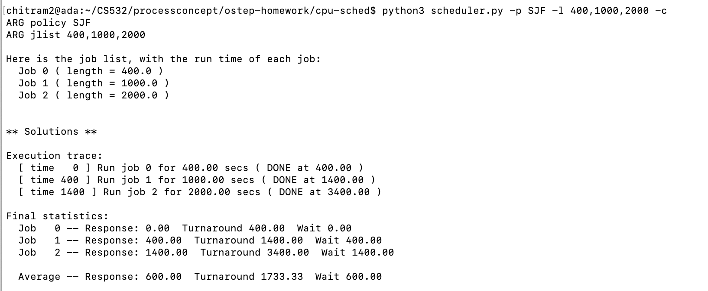
Ex4: when the job lengths are increased by a significant amount of unequal lengths.

Slide 45
For SJF scheduling algorithm with equal job lengths :
python3 scheduler.py -p SJF -l 400,400,400 -c
Process id | Wait time | Response Time | Turnaround time
Process 1 | 0 | 0 | 400
Process 2 | 400 | 400 | 800
Process 3 | 800 | 800 | 1200
For SJF Scheduling algorithm with an increase of 100 length per job:
python3 scheduler.py -p SJF -l 400,500,600 -c
Process id | Wait time | Response Time | Turnaround time
Process 1 | 0 | 0 | 400
Process 2 | 400 | 400 | 900
Process 3 | 900 | 900 | 1500

Slide 46
For SJF scheduling algorithm with an increase of 200 length per job:
python3 scheduler.py -p SJF -l 400,600,800 -c
Process id | Wait time | Response Time | Turnaround time
Process 1 | 0 | 0 | 400
Process 2 | 400 | 400 | 1000
Process 3 | 1000 | 1000 | 1800
For SJF Scheduling algorithm with unequal job lengths
python3 scheduler.py -p SJF -l 400,1000,2000 -c
Process id | Wait time | Response Time | Turnaround time
Process 1 | 0 | 0 | 400
Process 2 | 400 | 400 | 1400
Process 3 | 1400 | 1400 | 3400

Slide 47
Final Result
 | Average wait time | Average Response time | Average Turnaround time
EX 1 | 400 | 400 | 800
EX 2 | 433.33 | 433.33 | 933.33
EX 3 | 466.67 | 466.67 | 1066.67
EX 4 | 600 | 600 | 1733.33
In the above result that the length of the jobs increase, the average response time also starts to increase.

Slide 48
7. What happens to response time with RR as quantum lengths increase?
Provide an equation that gives the worst-case response time, given N jobs.

Slide 49
In the RR Scheduling algorithm, as the quantum length increase then the response times increase.
Provide an equation that gives the worst-case response time, given N jobs.
The time a process must wait for the next time slice is directly proportional to the number of other processes and the maximum time they can execute.
Let the Total processes n,
Quantum time size m,
then the process will have to wait for m(n-1) to respond to a request in the worst case scenario
Good

Slide 50
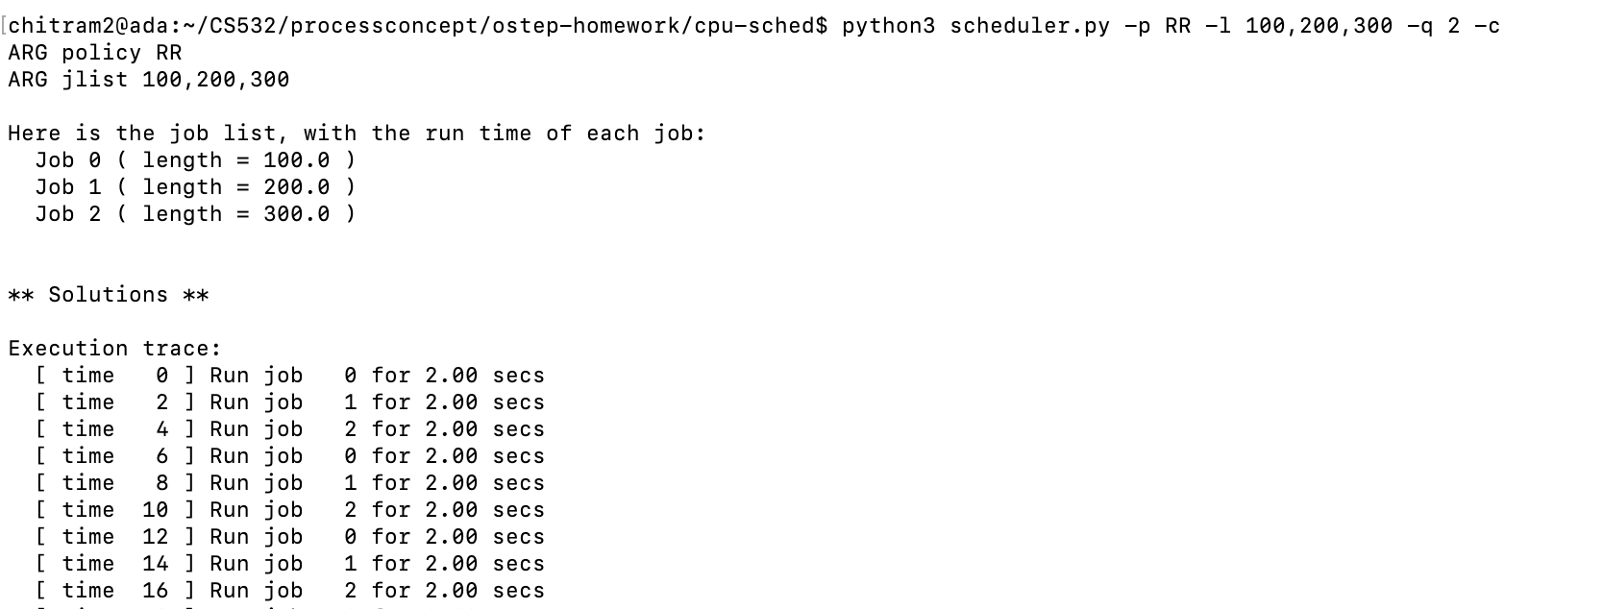

Slide 51
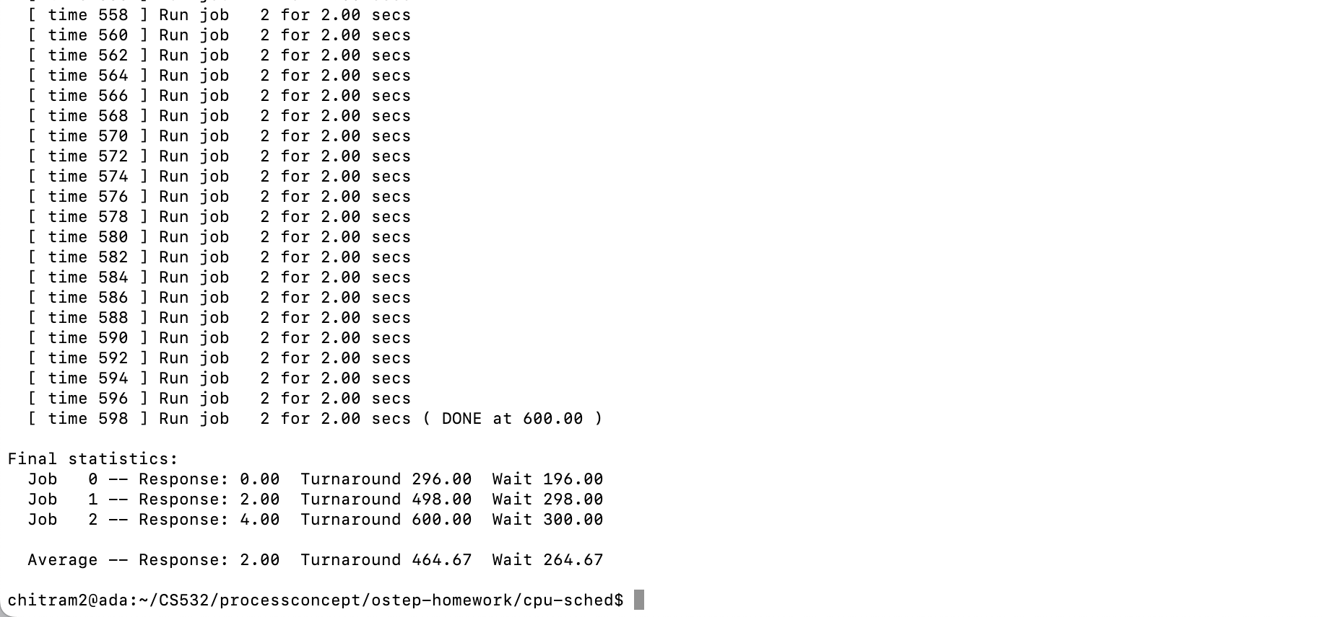

Slide 52
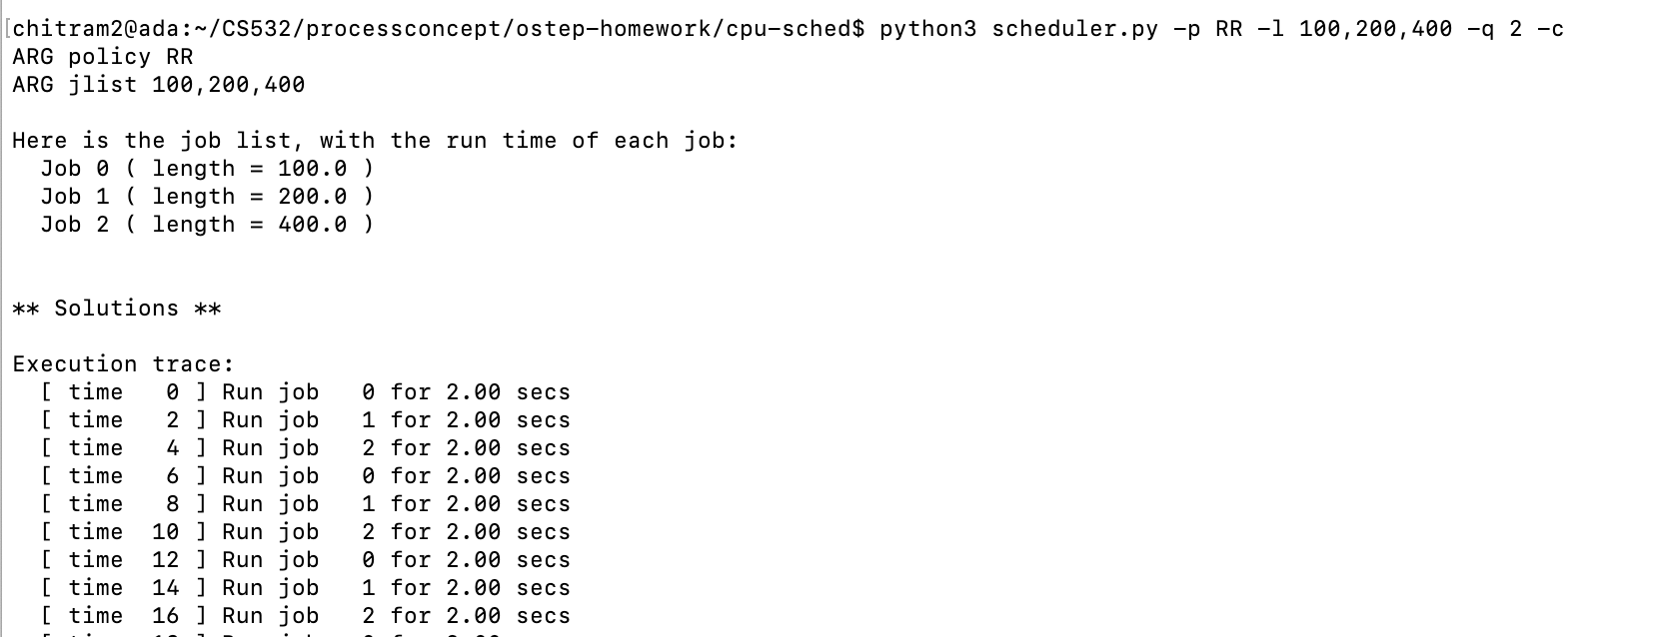

Slide 53
